Slide 1
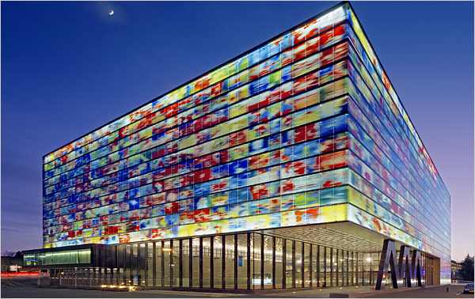
Supporting An Architecture
Have a guiding metaphor or structure to give context...

Slide 2

Different Dimensions of Development
Think about the social, political *and* technical dimensions of a project

Slide 3
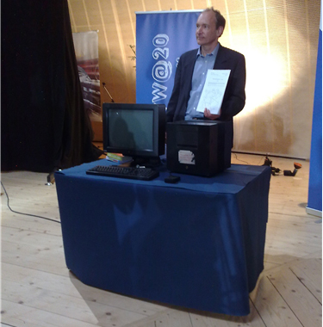
Look for Opportunities...
Great opportunities are often hidden; easy to see in hindsight...

Slide 4
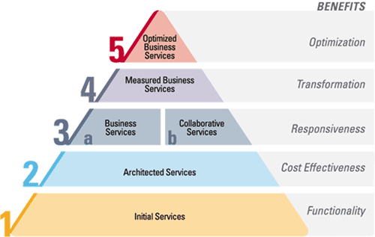
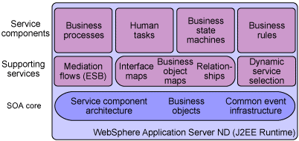

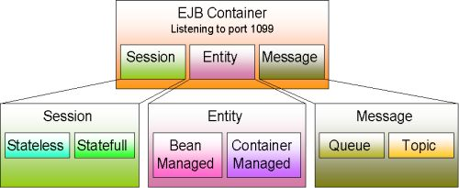
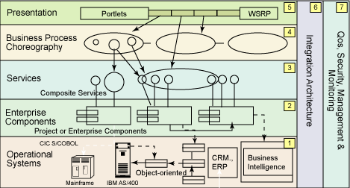
But Beware of Hype...
Review everything critically – form your own opinions...

